Slide 1
Apriori Algorithm
Suhas P
1GA19CS159

Slide 2

Apriori Algorithm
Apriori algorithm is used for frequent itemset mining and association rule mining.
The algorithm simply follows a basis that any subset of a large itemset must be a large itemset.
The Apriori principle can reduce the number of itemsets needed to be examined.
Apriori principle suggests if an itemset is frequent, then all of its subsets must also be frequent.
Assume X and Y are two itemsets. Apriori principle holds due to the following property of support measure:

Slide 3
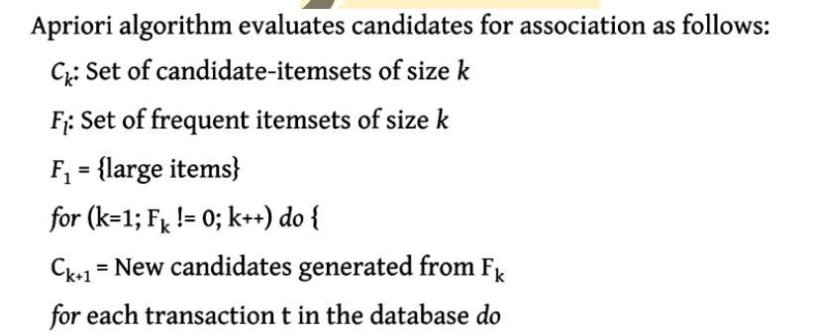
Apriori Algorithm
Increment the count of all candidates in Ck+i that are contained in Fk+i = Candidates in Ck+i with minimum support }

Slide 4
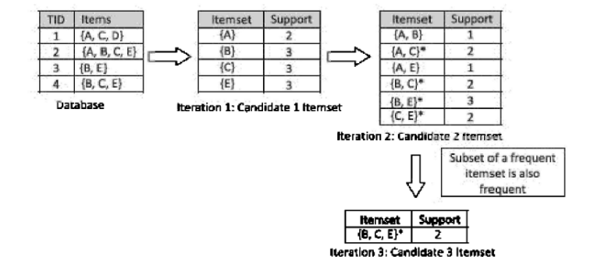
Apriori Example

